Slide 1


Deep Learning Theory and Applications RNNs and LSTMs
CPSC/AMTH 452/552
CBB 663

Slide 2
Question
Do CNNs work on data with time structure rather than space structure?
What if the time-structure has variable lengths?

Slide 3

Fixed sized inputs
Normal neural networks have to have predetermined input size

Slide 4
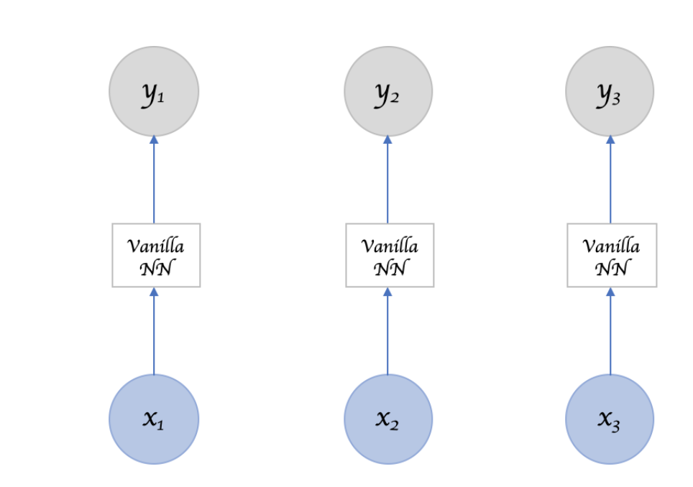
Contrast with calling NN repeatedly
Order and sequence matters

Slide 5
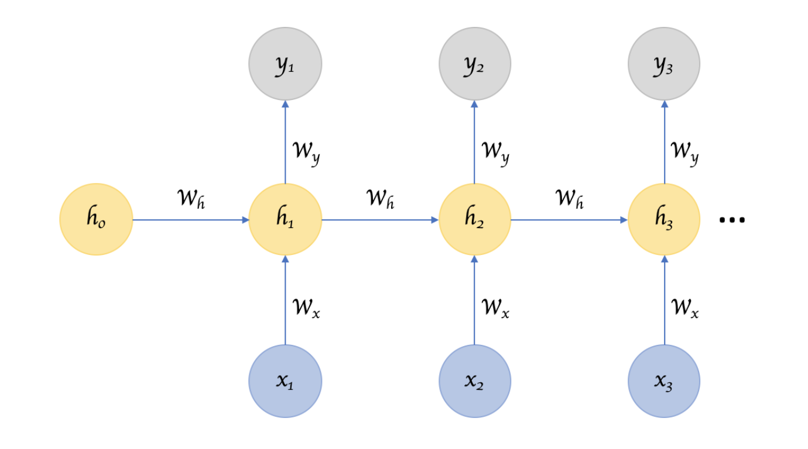
Recurrent Neural Networks
Takes arbitrarily sized inputs and
“remember” a hidden state of
information

Slide 6
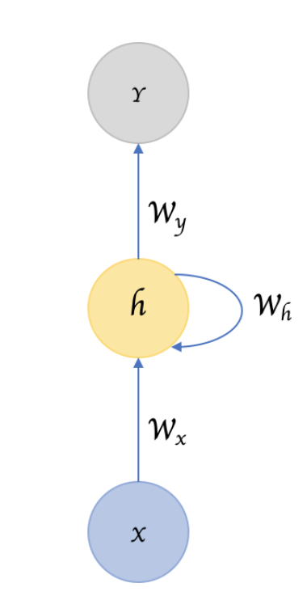
Feed forward vs Self-Loops

Slide 7
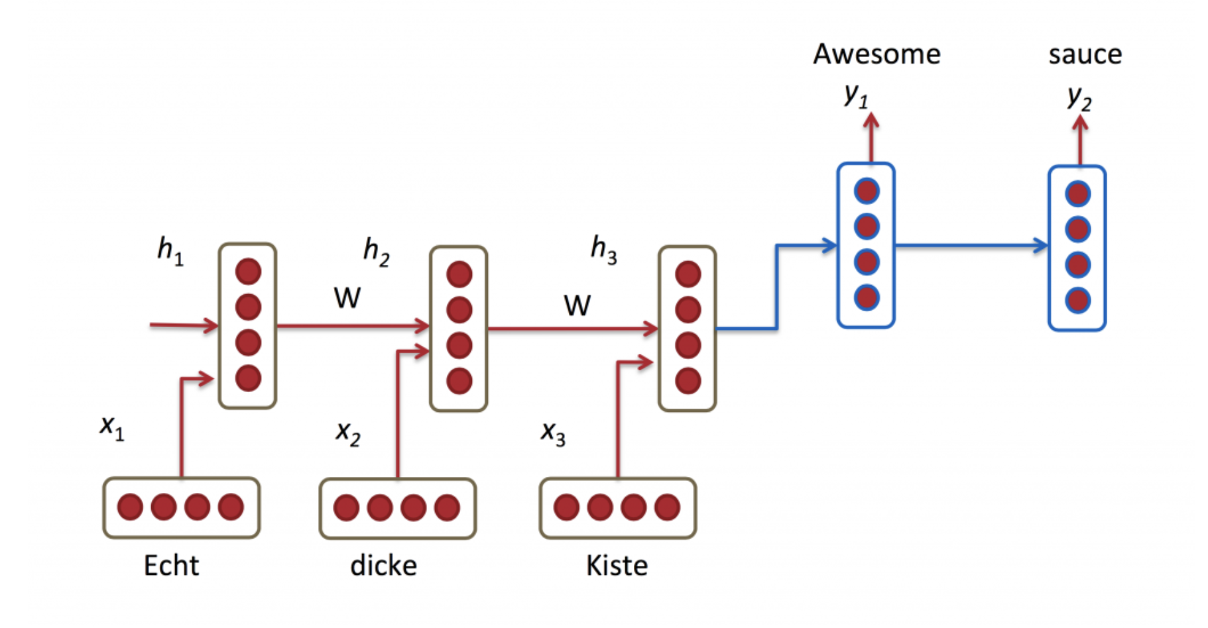
Processing Sequential Input

Slide 8
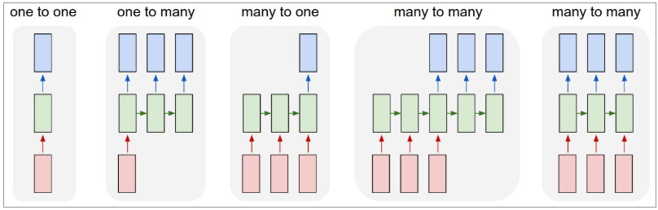
Sequence oriented tasks
Variable length inputs, variable length outputs, variable length computation

Slide 9
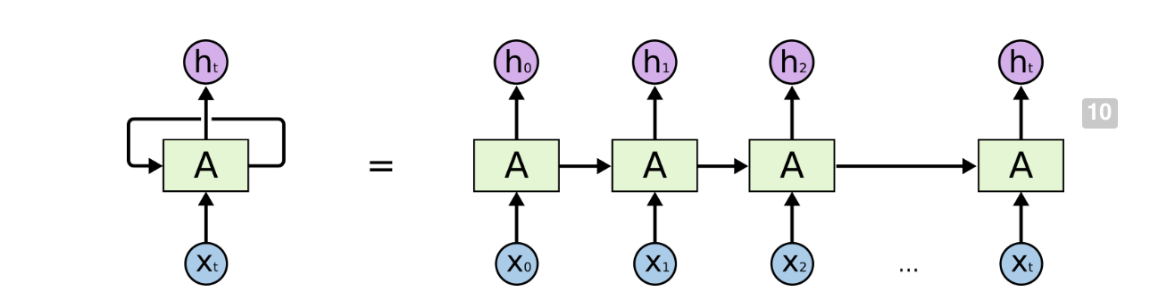
Backpropagation Through Time (BPTT)

Slide 10
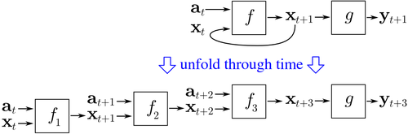
All unfoldings share parameters

Slide 11
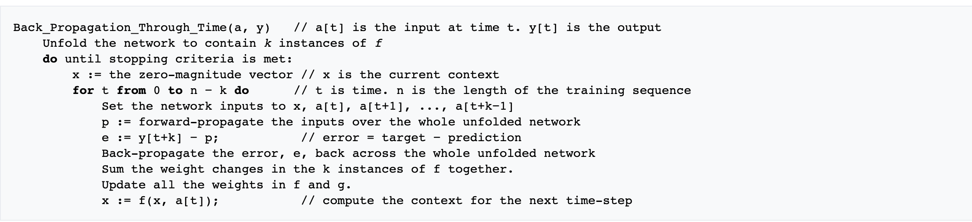
BPTT Computes Gradients for Many Time Steps

Slide 12
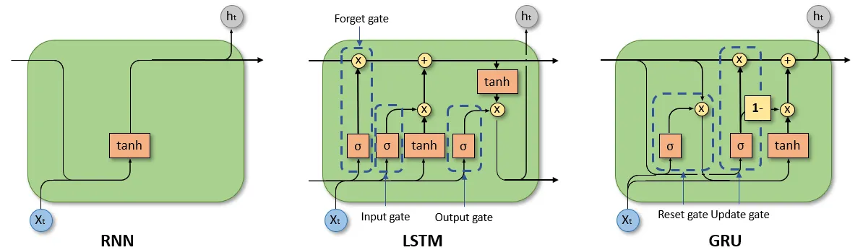
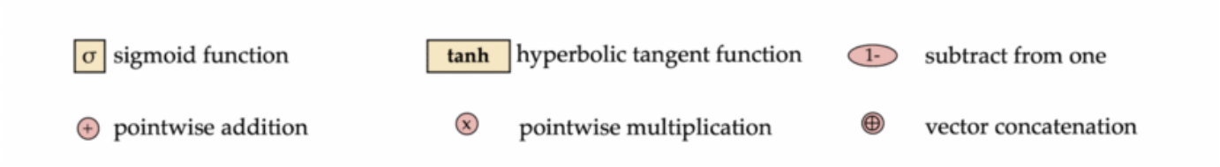
Comparison of unit of RNN, LSTM, GRU

Slide 13
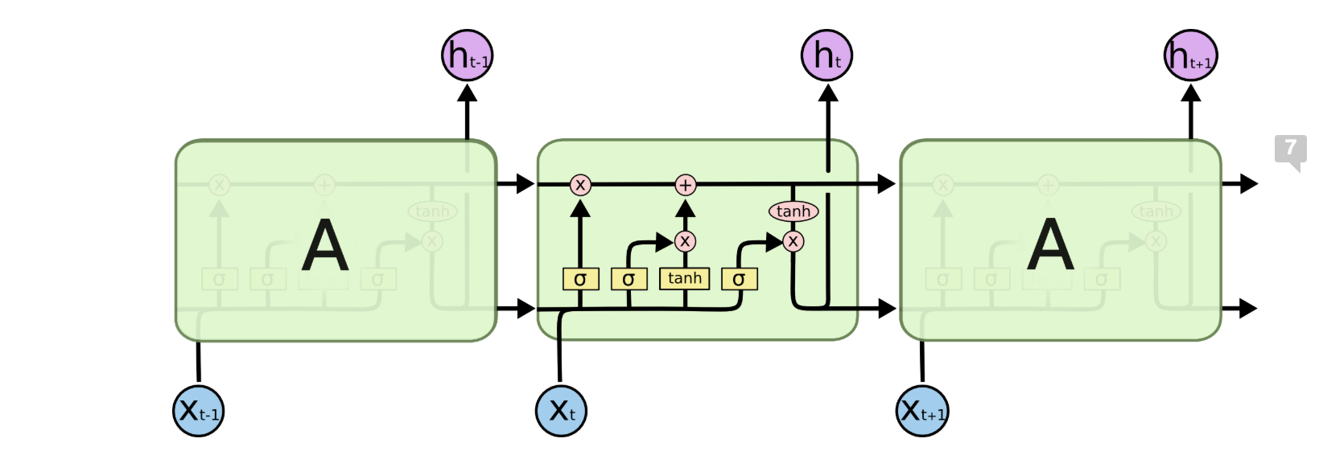
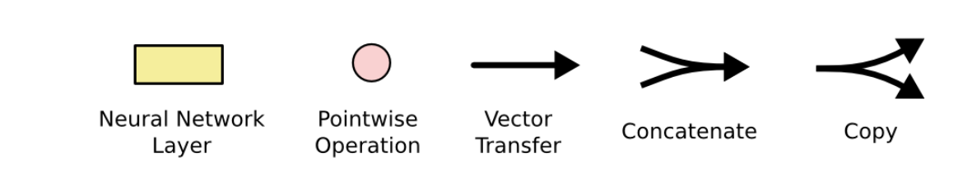
Notation

Slide 14
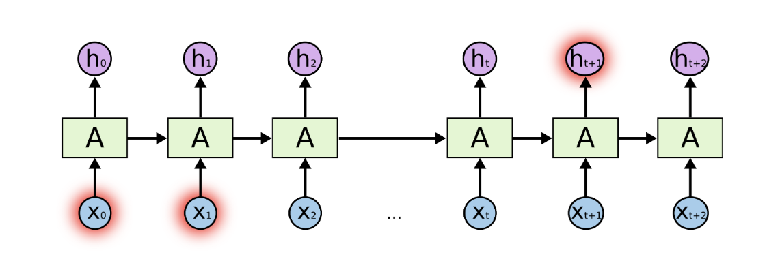
RNNs not good at handling long term dependencies

Slide 15
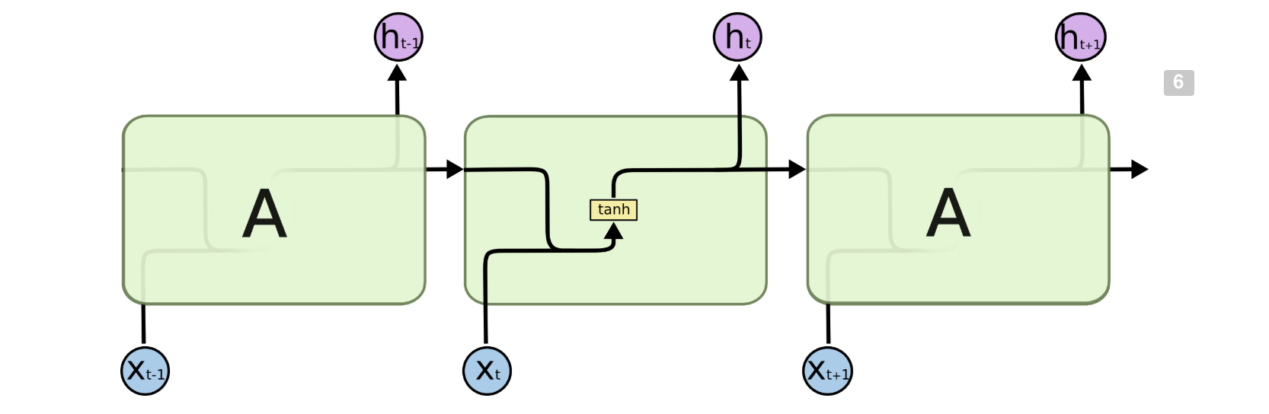
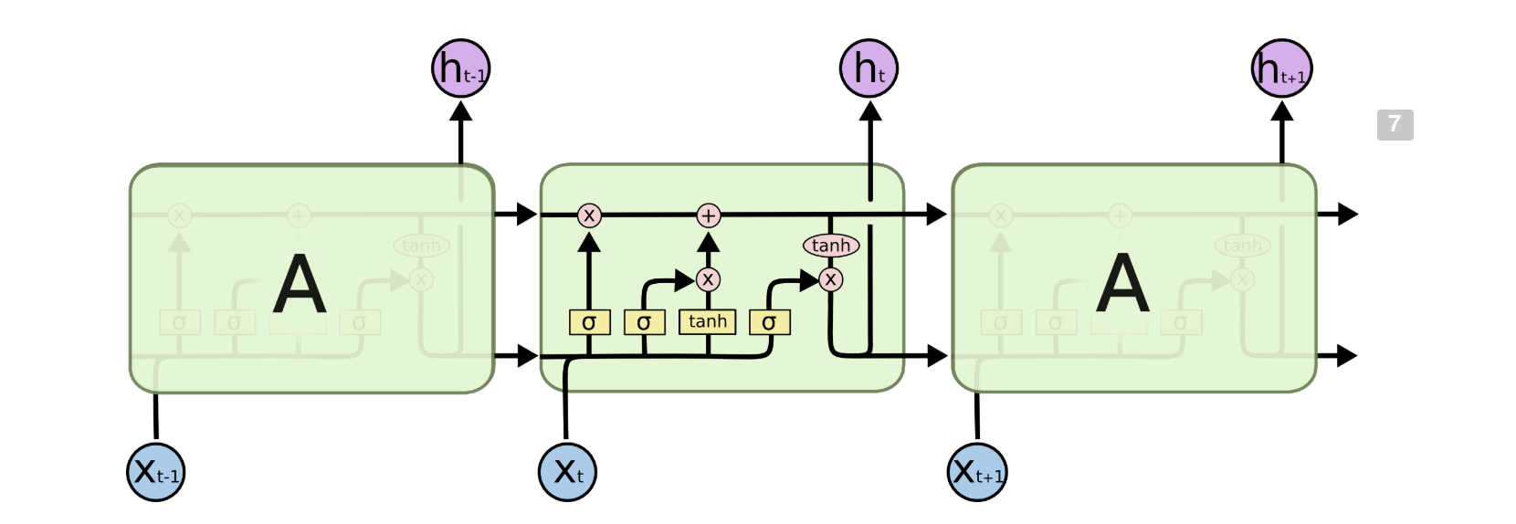
LSTMs

Slide 16
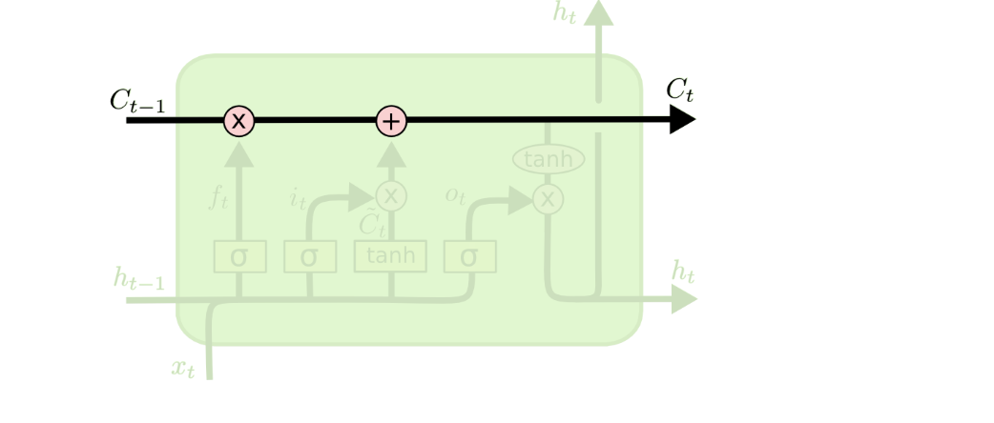
Running Cell State

Slide 17
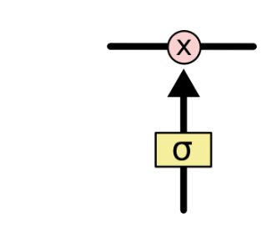

Gates modify hidden state
A gate is implemented as a sigmoidal layer that outputs a value between 0 and 1 and controls how much of an input should be let through
0=don’t let anything through
1= let everything through
Indicates pointwise multiplication

Slide 18
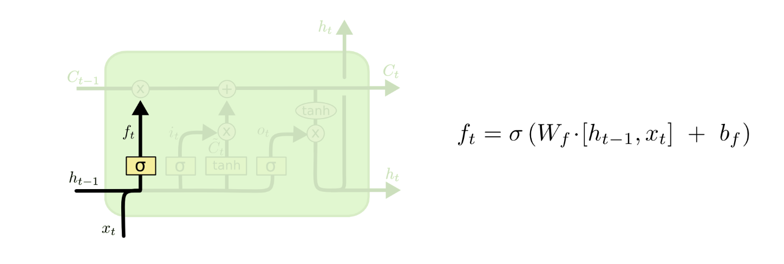
Forget Gate
How much of the previous hidden state should be forgotten?

Slide 19
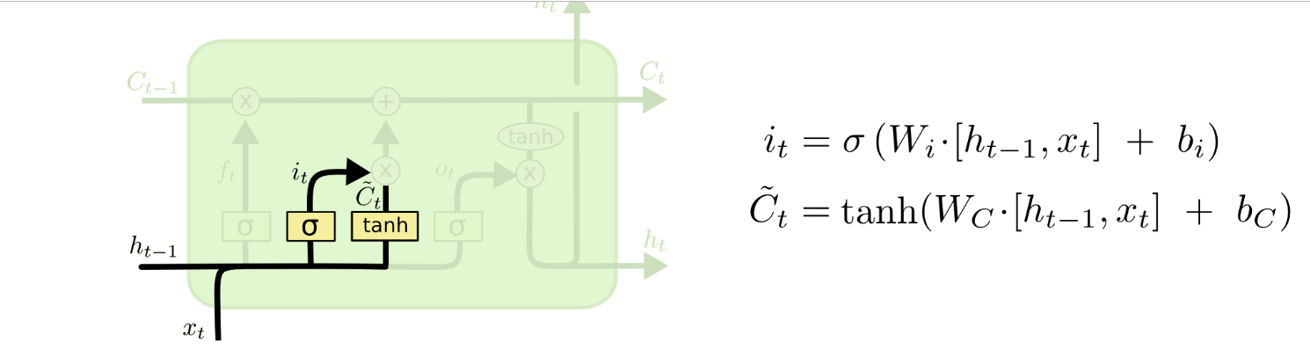
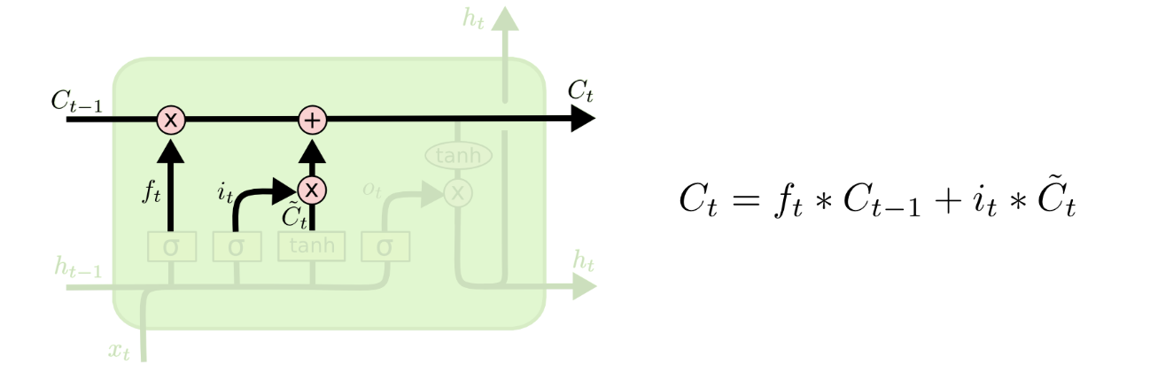
Creating New Hidden State

Slide 20
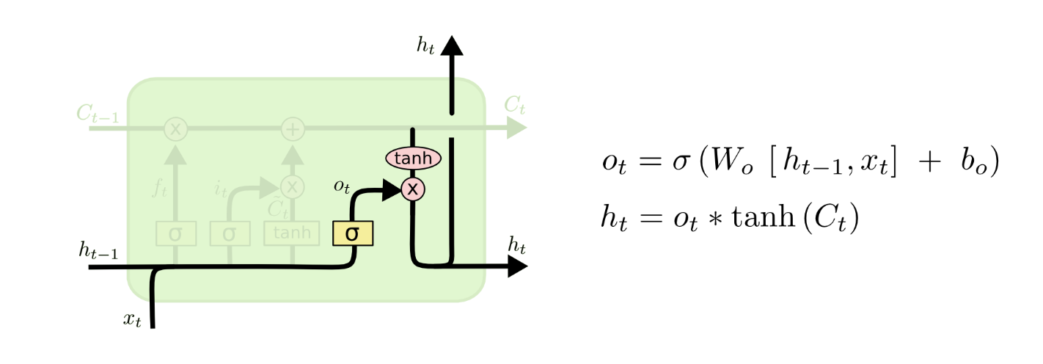
Output

Slide 21
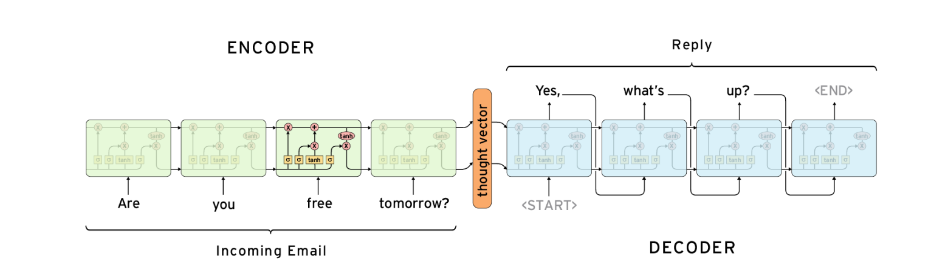
seq2seq model: LSTM Autoencoder
Email autoreply
German sentence
Ich ging nach [EOS]
Machine translation
I want go home
English sentence
reconstructued sentence
I want go home
language modeling
I want go home
original sentence

Slide 22
Natural Language Processing
Field of AI concerned with interactions between humans and computers
How to program computers to process and analyze natural language data (as opposed to computer languages)

Slide 23
NLP Tasks
Speech recognition
Natural language generation
Natural language understanding
More specific tasks
Machine translation
Sentiment Analysis
Question Answering
Text generation

Slide 24
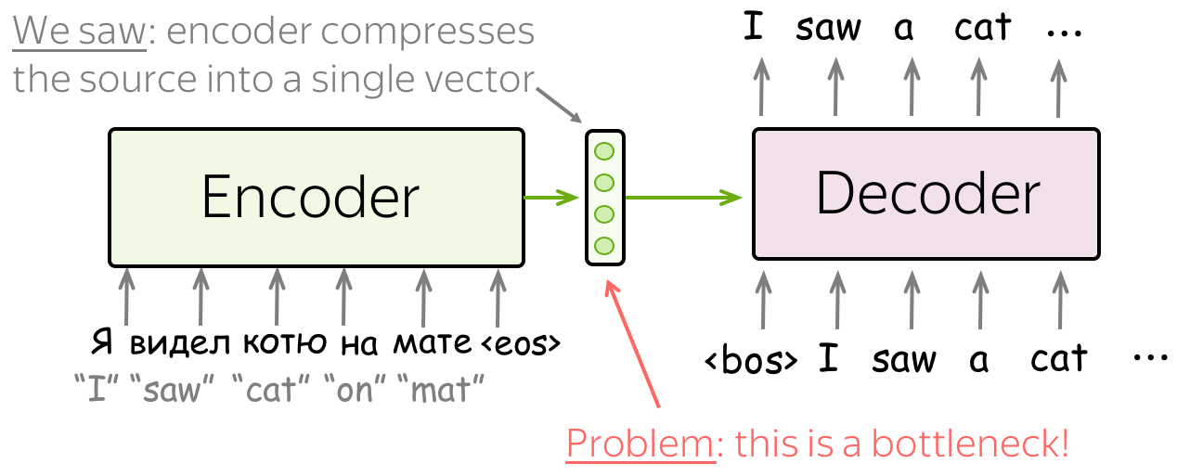
Problem

Slide 25
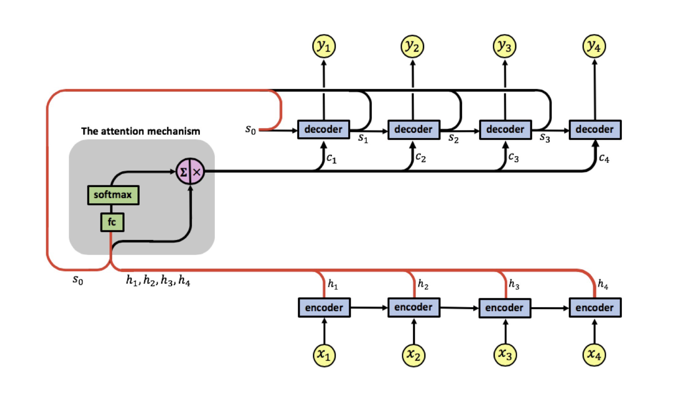
Adaptively Allows Decoder to Choose Inputs

Slide 26
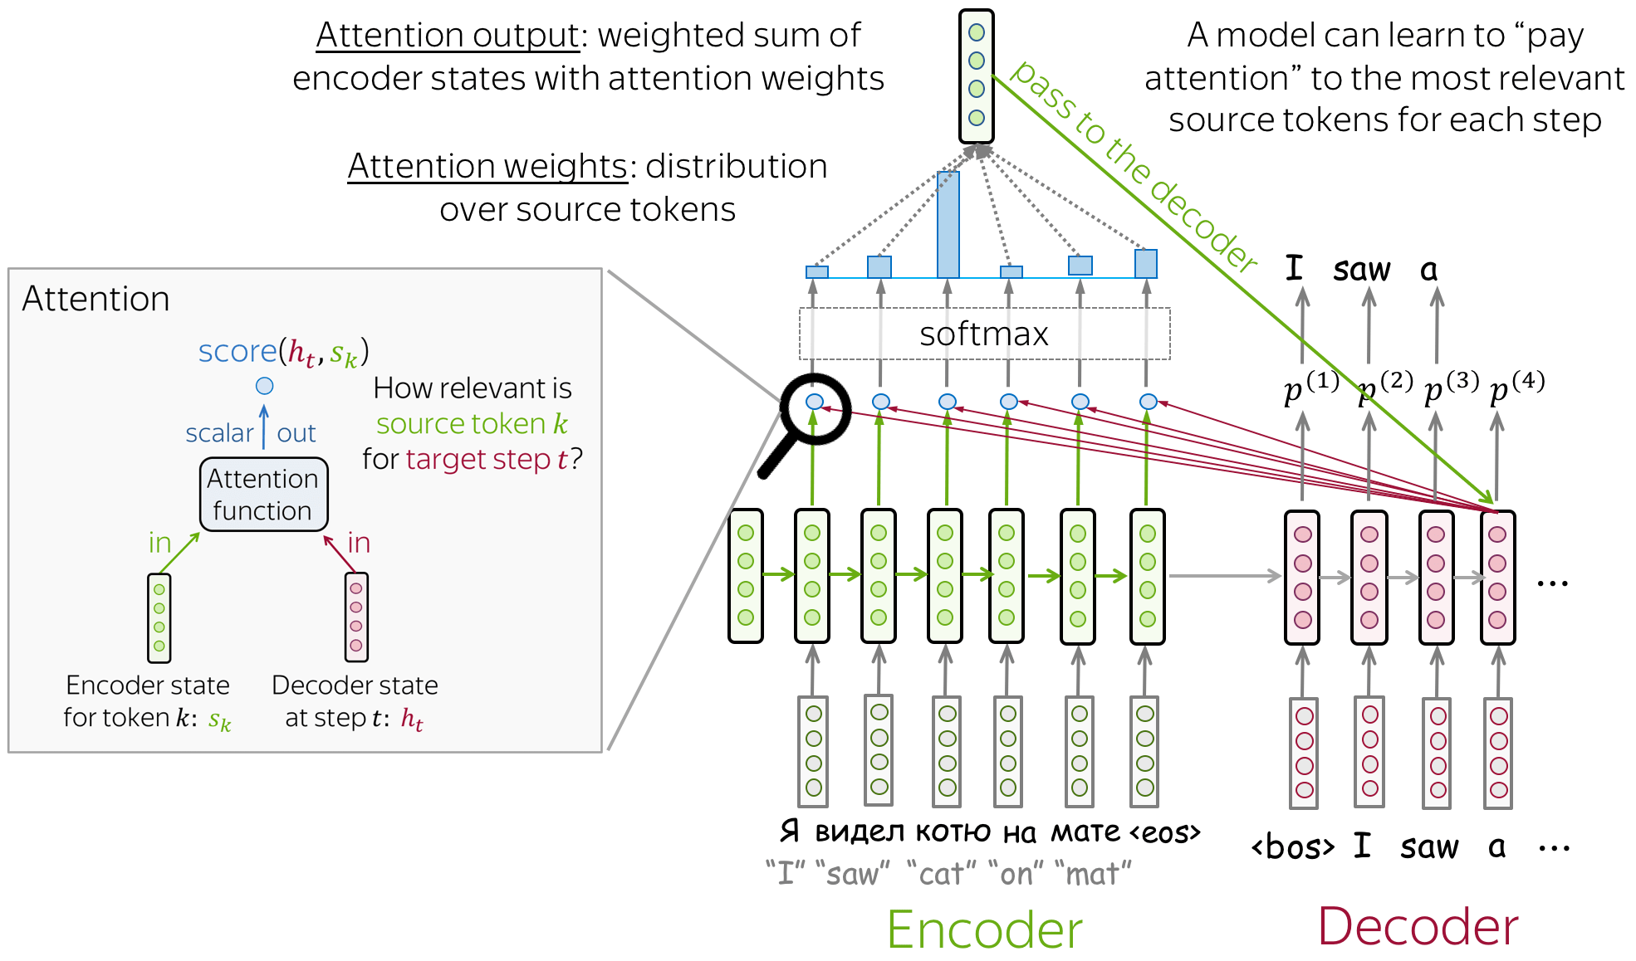
Attention Mechanism

Slide 27
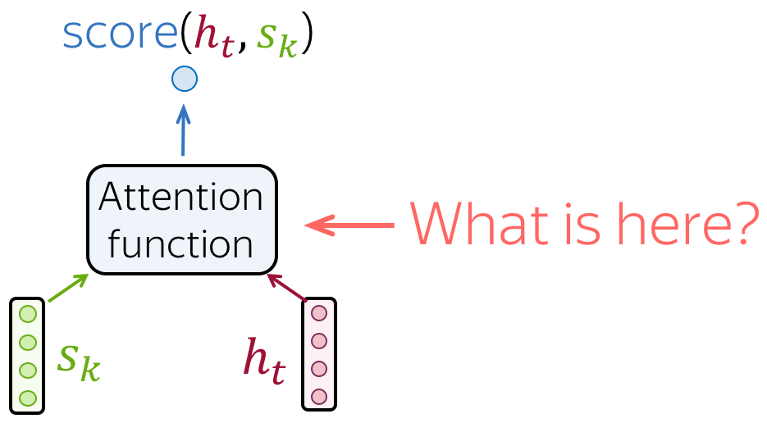
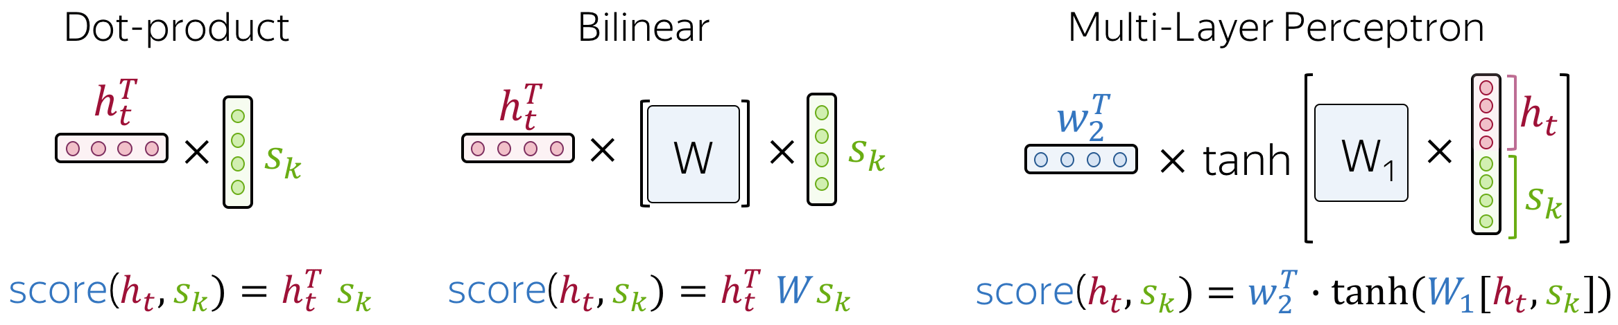
Attention Score

Slide 28
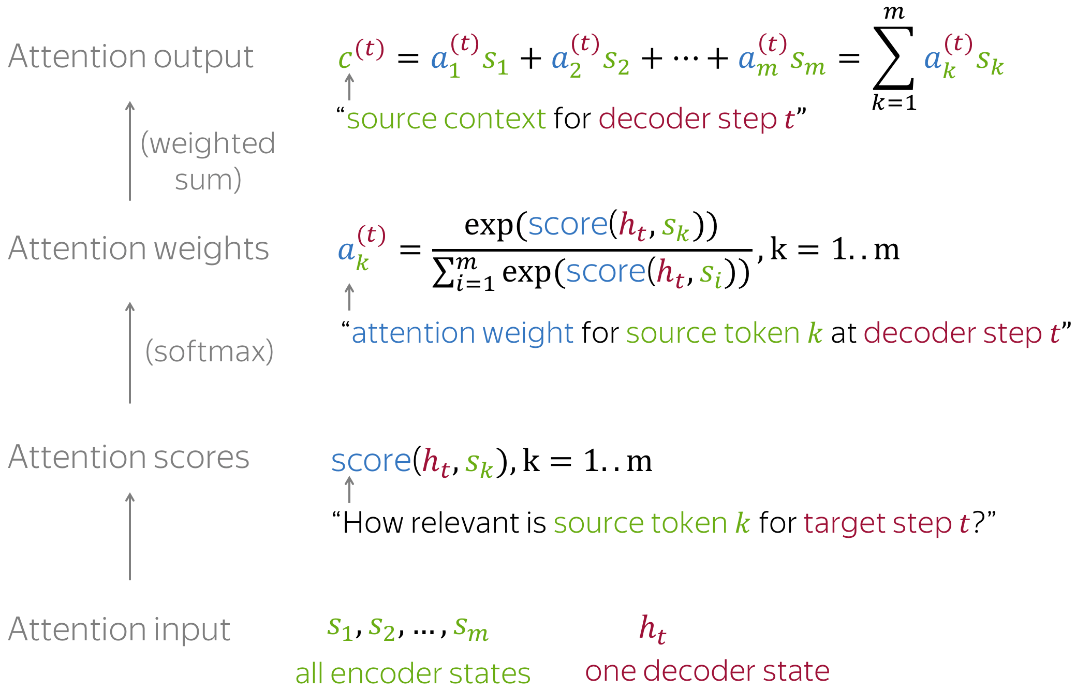
Attention Computations

Slide 29
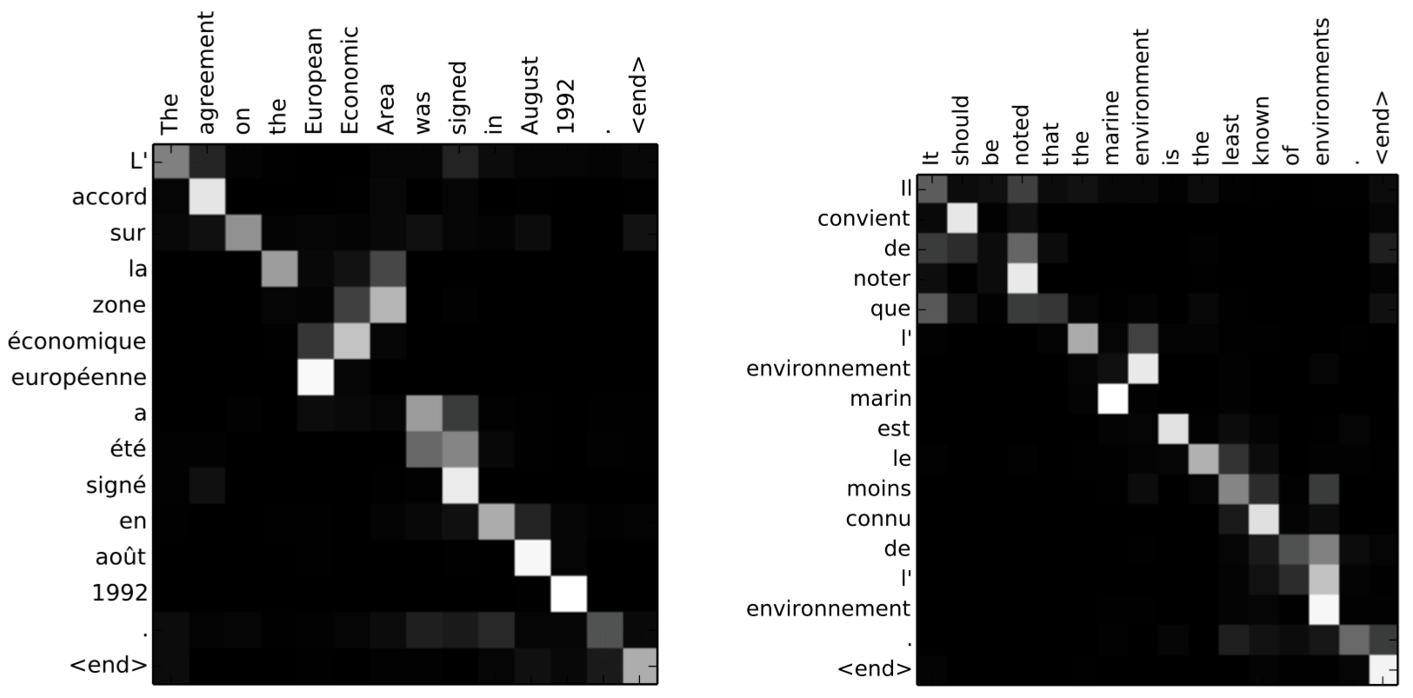
Interpreting Attention

Slide 30
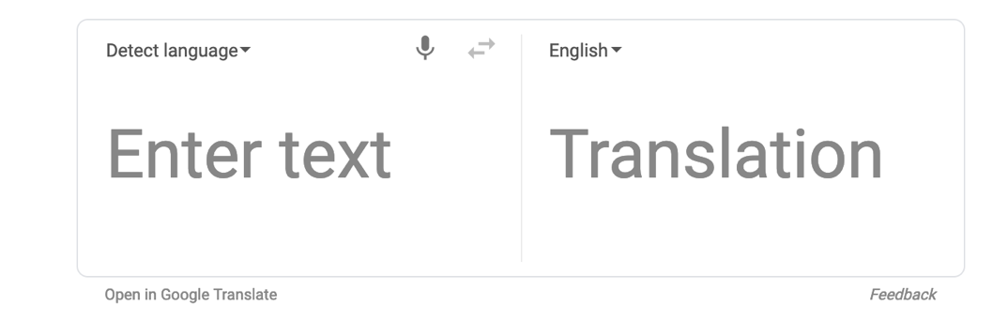
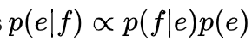
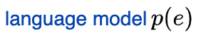
Machine Translation
Statistical machine translation:
P(e|f) e = english phrase f= foreign phrase
Translates n-grams phrases consisting of n-words

Slide 31
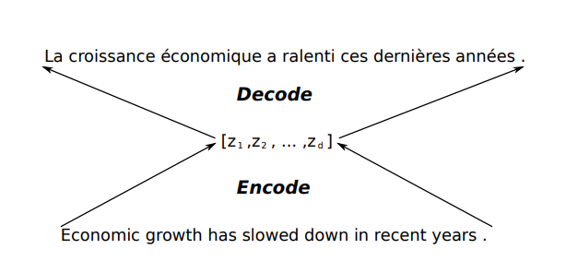
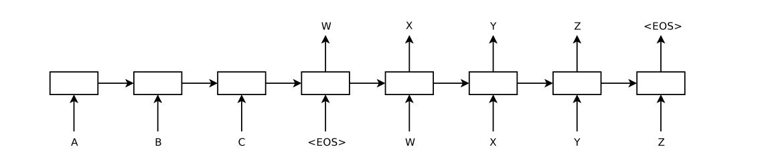
Neural Machine translation
Encoder-decoder architecture
Cho et al 2014, Sutskever 2014

Slide 32
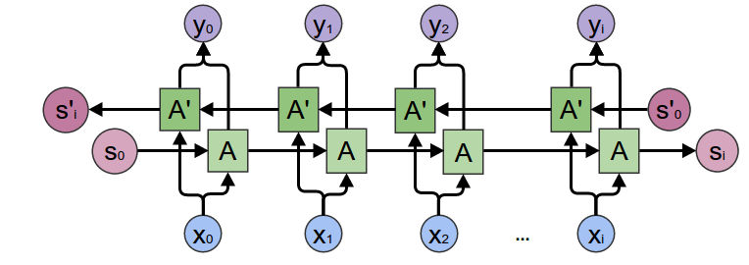
Bidirectional RNN

Slide 33
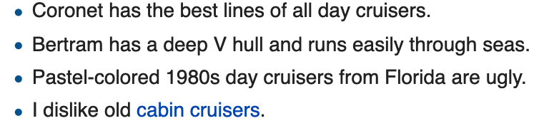

Sentiment Analysis
I do not dislike cabin cruisers. (negation handling)
Polarity:

Slide 34

Beyond Polarity

Slide 35
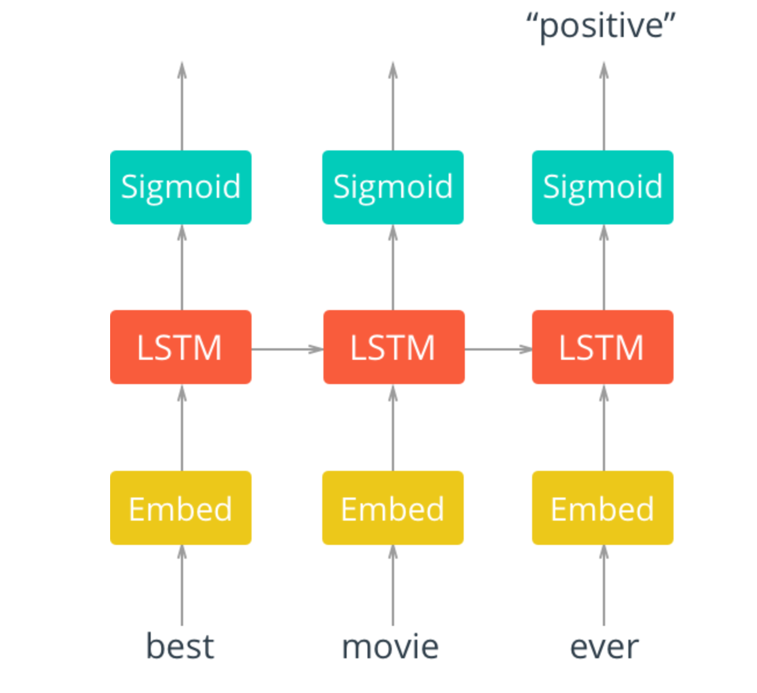

Slide 36
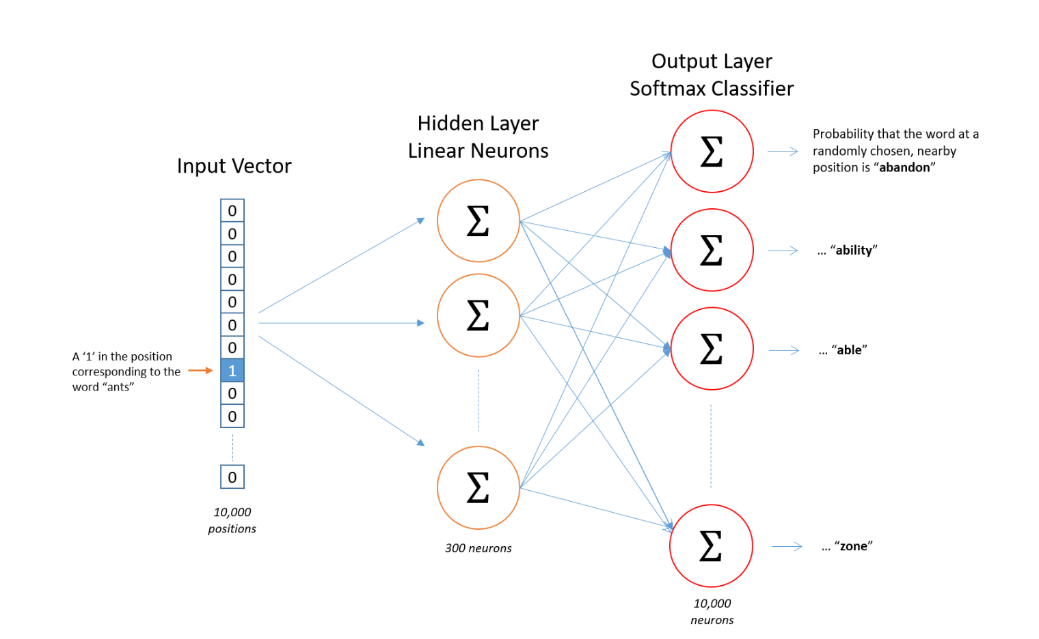
Word vector Embedding

Slide 37
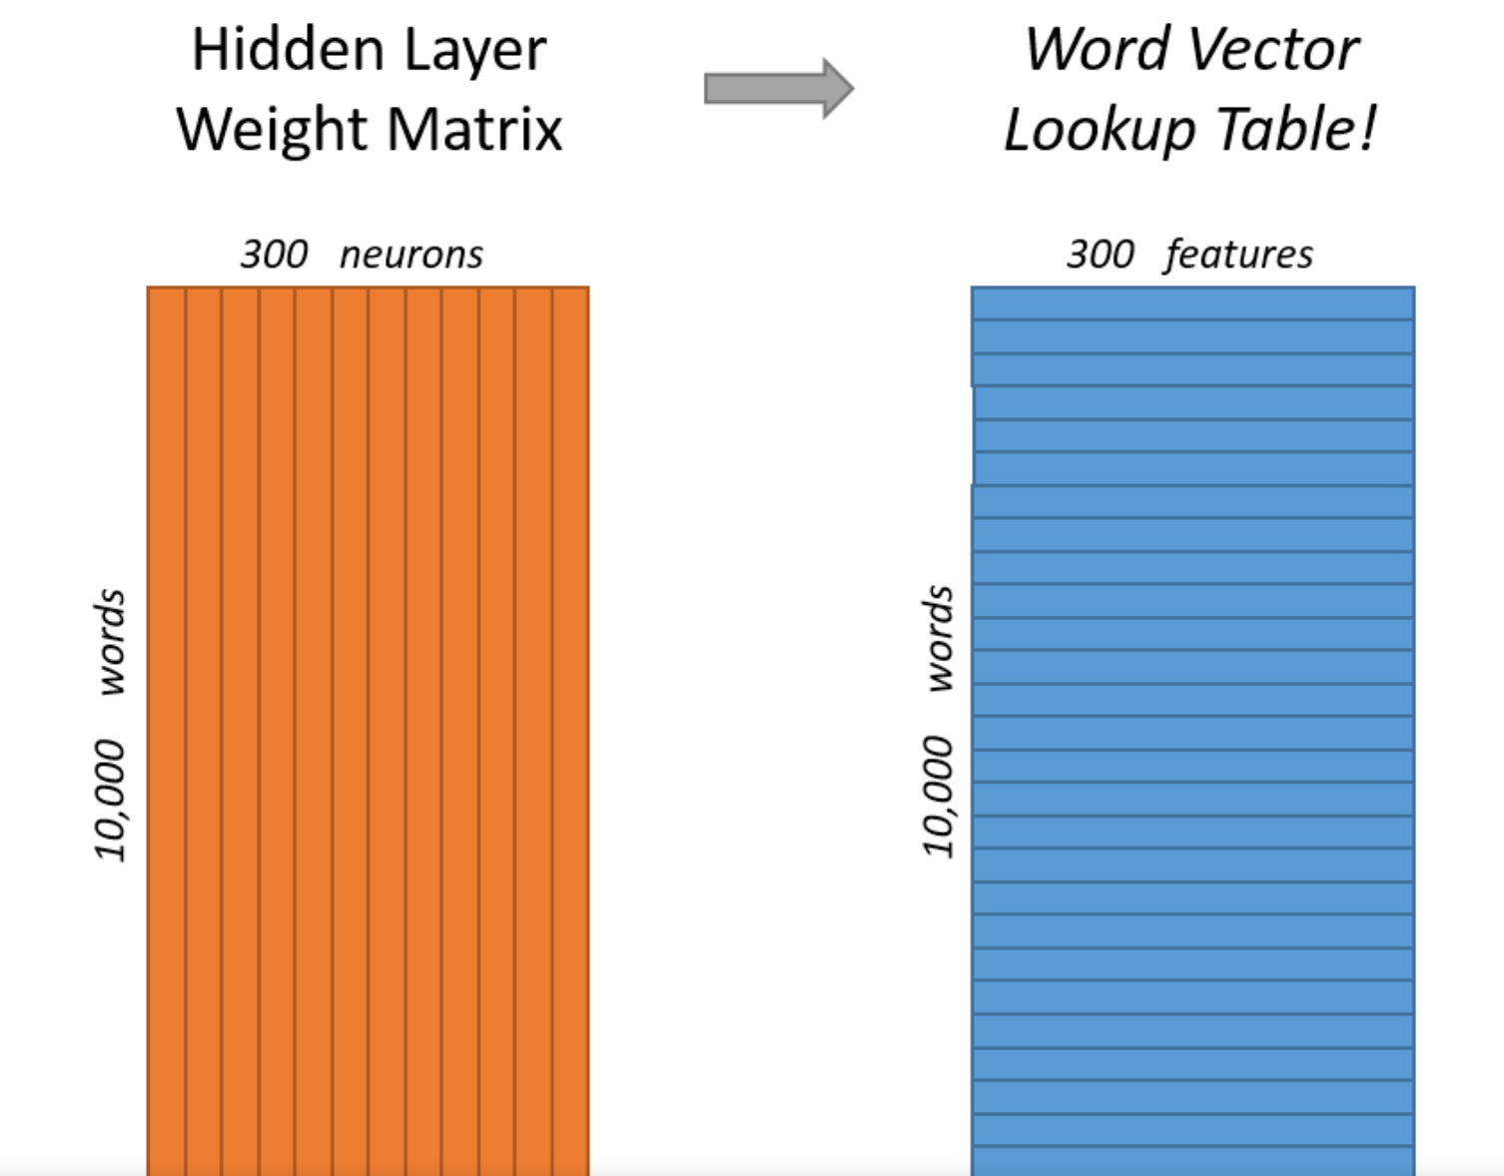
Word vectors

Slide 38
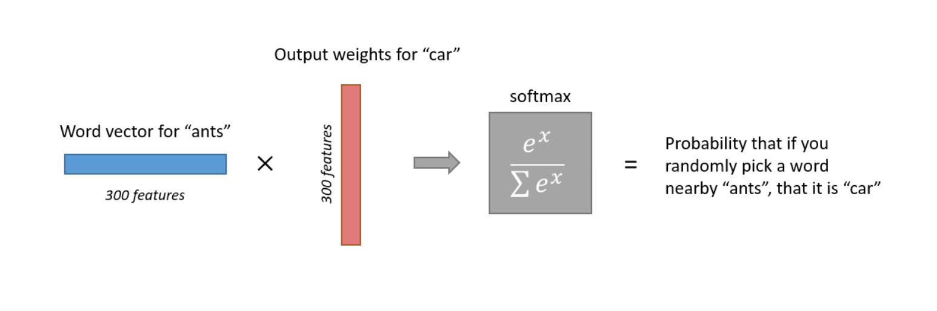
Output calculation
Training on negative samples improves this.

Slide 39
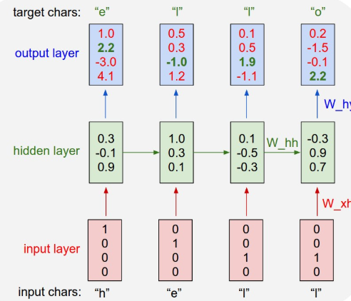
Character Level Language Model

Slide 40
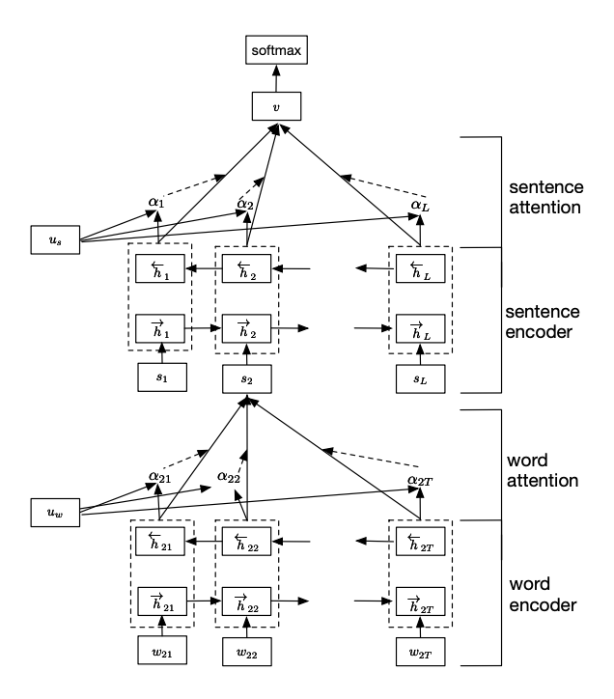
Hierarchical Model

Slide 41
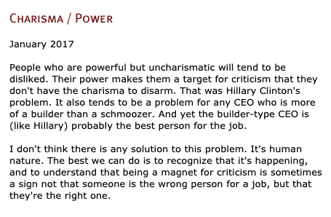
Text Generation
Text generation databases: Paul Graham Essays, Project Gutenberg

Slide 42
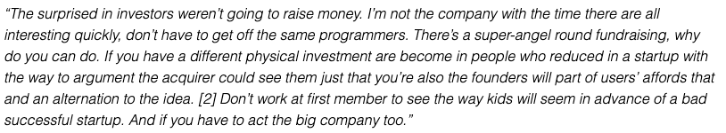
RNN for Text Generation
2-layer LSTM

Slide 43
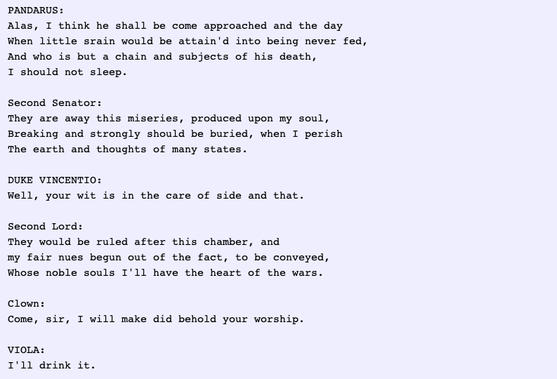
Depth helps!
3-layer LSTM

Slide 44
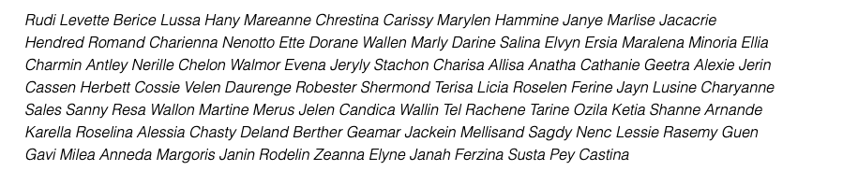
Baby Names
New names that have not been sampled before!

Slide 45
Evolution of a language model: Iteration 100
What did the network learn so far?
Words and spaces.

Slide 46
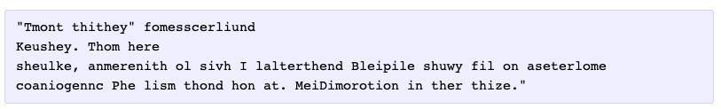
300 Iterations
Punctuation

Slide 47
Iteration 500
Spelling short words

Slide 48
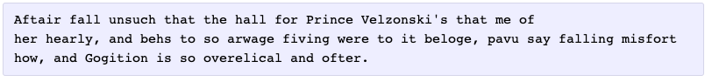
Iteration 700
Word ordering

Slide 49
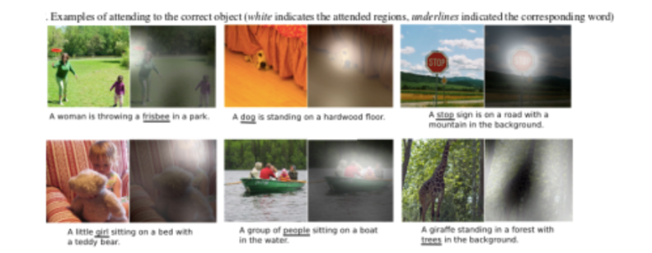
Image Captioning

Slide 50
Reading list
Chapter 10 Goodfellow
Miklov et al. Efficient Estimation of Word Representations in Vector Space ,2013
Luong et al. Effective Approaches to Attention-based Neural Machine Translation 2015
https://arxiv.org/pdf/1409.0473.pdf
Hochreiter & Schmidhuber Long Sort Term Memory, 1997
https://medium.com/datadriveninvestor/attention-in-rnns-321fbcd64f05
http://colah.github.io/posts/2015-08-Understanding-LSTMs/
https://lena-voita.github.io/nlp_course/seq2seq_and_attention.html

